Slide 1
CISC 400 Presentation
By: Jonathan Evans

Slide 2
Advanced topic
I choose the advanced topic: Rotate a 3D object with the mouse.
In this presentation, I will be going over and breaking down different aspects of the code.
The goal of this presentation is to give you a better understanding of the concepts in WebGL.

Slide 3

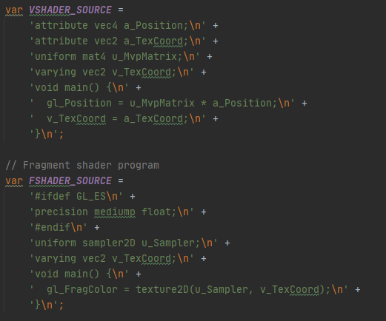
Vshader and fshader
Here are the Fragment and Vertex shaders.
The variable gl_FragColor will hold the color information of the texture.

Slide 4
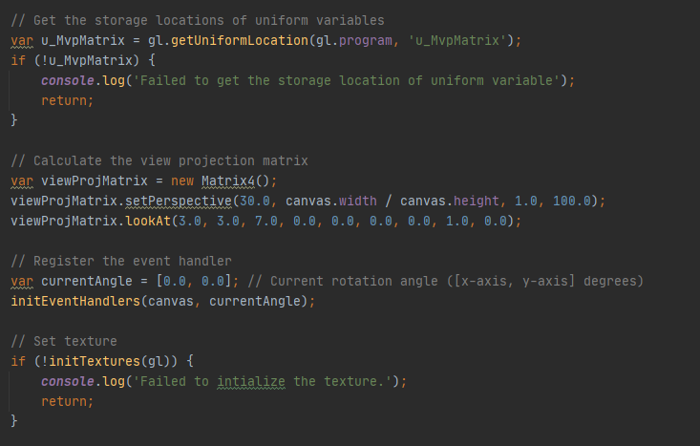
Perspective
The declaration of uniform variables (u_MvpMatrix).
viewProjMatrix sets the perspective for the users using .lookAt().

Slide 5
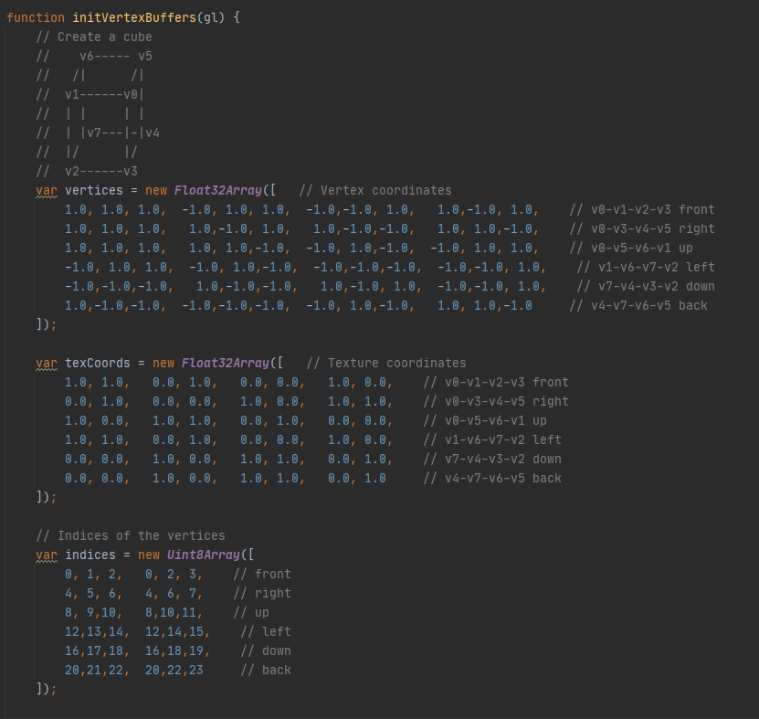
Vertices and indices
Vertices variable holds each vertex point.

Slide 6
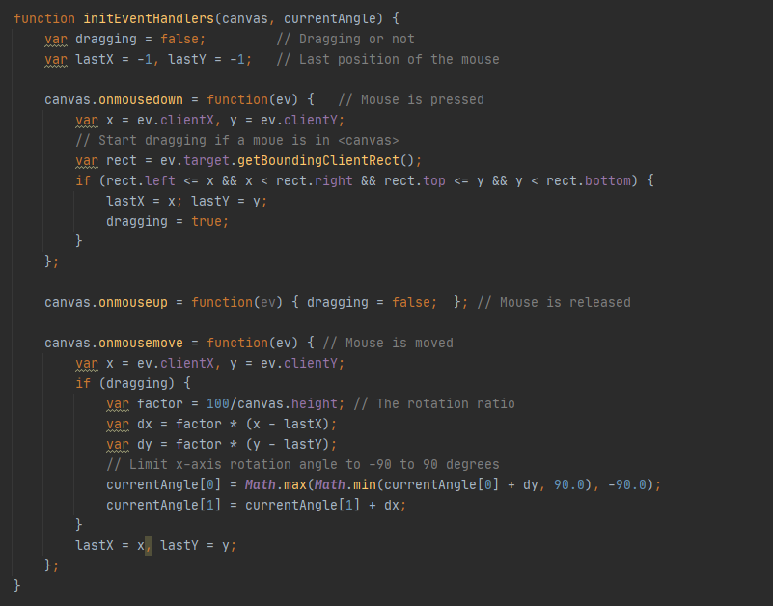
Dragging(Animation)
The code listens for mouse movement within the canvas.
If the mouse enters the boundaries of the canvas, it will listen for the user to click within the canvas and move their mouse.
If the user lets go of the mouse, they will no longer be able to rotate the cube.
Onmousedown and onmousemove listen for the mouse movement.

Slide 7
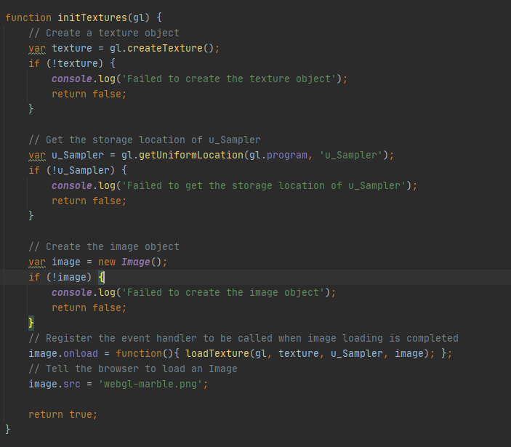
Textures
Var Image will be a variable that holds the image. In this case, it is the “webgl-marble.png”

Slide 8
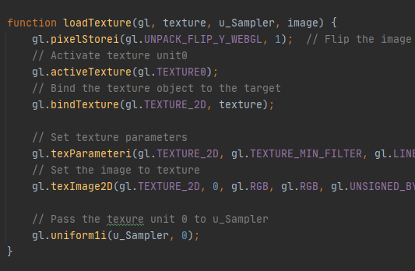
Textures (cont.)
The loadTexture function simply prepares all the variables to load the textures.
At the end, the texture is passed to u_Sampler, where it will eventually be combined with TexCoord to produce the color information of the texture.

Slide 9
References
Matsuda & Kanda, 2012, “RotateObject.js”.

